Slide 1
DC Motors

Slide 2
What is a motor?
Wiki says: “…an electrical machine that converts electrical energy to mechanical energy”

Slide 3
Parts of motor
Rotor, stator, windings in stator, commutator
Rotor = carries motor shaft (& magnets / current field. Rotates around poles)
Stator = stationary
Commutator keeps torque from reversing. Electrical contacts on commutator are “brushes”
Brushes = conducts current through wires

Slide 4
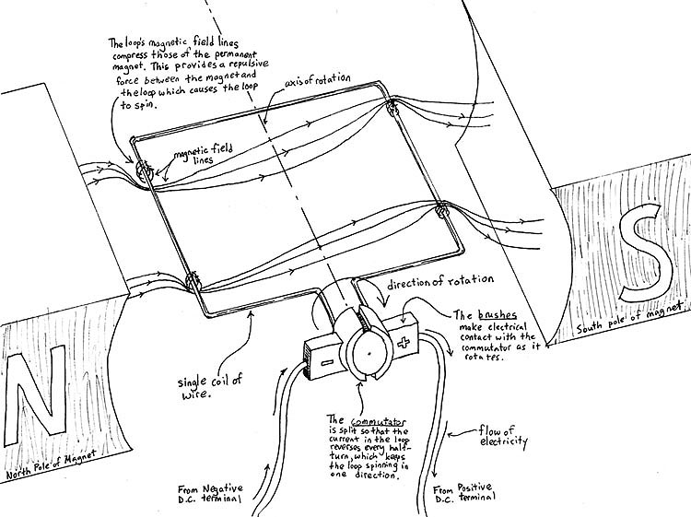
Applied electric field interacts
with Magnetic poles of
permanent magnet

Slide 5
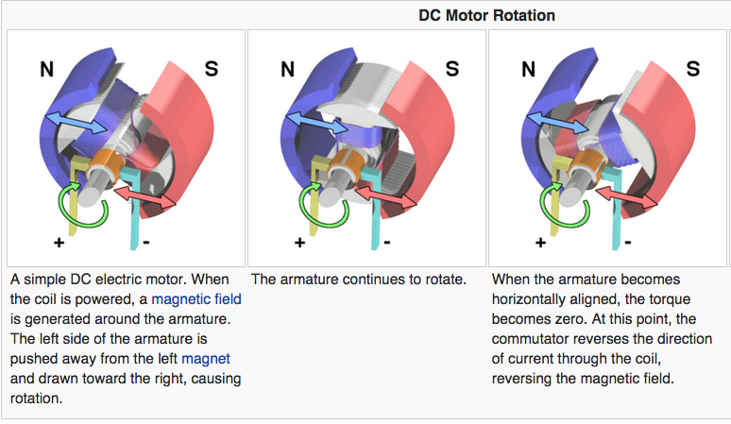

Slide 6
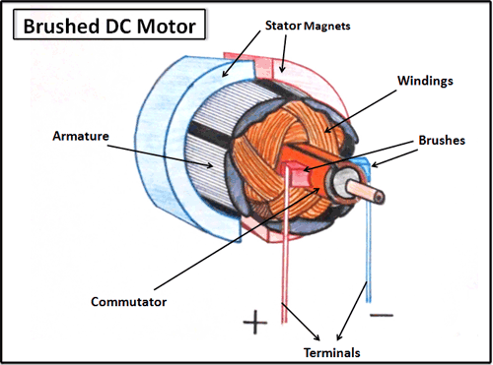
Motor types
Brushed DC motors = brushed continuous rotation.
Control direction/speed
Two wire control
Extreme
environments cause
No electronics

Slide 7
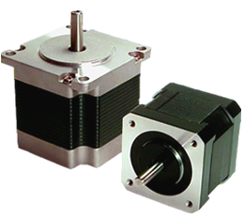
Motor types cont…
Brushless DC motors = no brushes (steppers…kinda)
BLDC motors continuous, steppers “steps”
High efficiency, no brushes = no wear, precision control, driving circuit
Cons = Complex control,
high cost

Slide 8
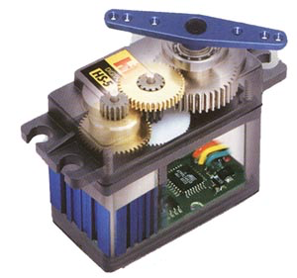
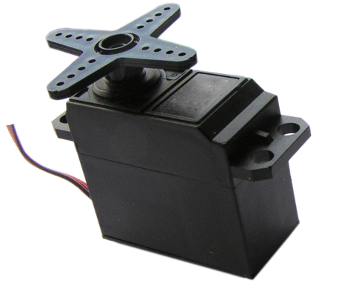
Motor types cont..
Servo = feedback position motor
Gear set, control circuit, position sensor, DC motor
3 wires: send PWM into signal
Rotates to exact position
Weight limits
Found in RC planes, robotics,
animatronics

Slide 9
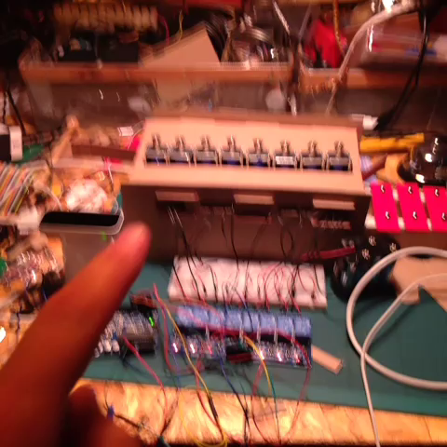

Variations of motors/actuators
solenoids
Muscle wire

Slide 10
Further reading
Brushed vs brushless:
http://www.dynetic.com/brushless%20vs%20brushed.htm

